Slide 1
Multi-Agent System Simulation with
RePast Simphony
Nan Zhang, Christian Vergara
12250056@mail.sustech.edu.cn

Slide 2
Agenda
Objective:
  - Familiarize with RePast Symphony simulator
  - Develop step by step the Zombie tutorial
  - Identify the components to model Agents and a Environment
  - Map the concepts with the RePast (using Java) to develop your own agents and their behavior
  - Difference between a single Agent and OOP

Slide 3
Execution model
RePast is a discrete event simulator:
  Schedule: [(e1,t),(e2,t2), … , (en, tn)]
  Each event is taken off and executed
e1: is implemented by defining a class which has a method annotated with:
  @ScheduledMethod(start = 1, interval = 1)
  Typically define an agent….
    public class SimpleAgent {
    @ScheduledMethod(start = 1, interval = 1)
    public void step() { // Override by subclasses }
    }

Slide 4
Agents
SENSE – THINK – ACT
Humans:
  Scape from Zombies around their sensed area
  They have an initial amount of “energy”
Zombies:
  Look for humans around their sensed area

Slide 5
Environment
In Repast Simphony use a context to describe the environment. Implement the ContextBuilder<AgentClass>.
The context contains the agents and also executes them (contains schedule).
  It manages also “Projections” that can be seen as Layers where the agents are situated

Slide 6
A simulation
You have a context which contains some events which are executed.
Or you have a list of objects which implement a method annotated by ScheduledMethod.
That’s it! – you are free to implement the agent, events and anything else however you like!

Slide 7
Quick RePast demo

Slide 8
Let’s create our Simulation with RePast
Follow the Zombie Tutorial (until page 21) 1
Requirements:
  OOP concepts
  Some Java skills
1 https://repast.github.io/docs/RepastJavaGettingStarted.pdf

Slide 9
Multi Agent System
Challenges:
  In the tutorial:
  - Can Humans be infected and turned into Zombies?
  Not in the tutorial
  - Can humans look for other humans (make groups)?
  - Could there be some “Shelters” in the environment to protect them?
  - How can the agents get to them using their resources optimally (maximizing food use)
  - What if the environment continuously generates zombies and resources?

Slide 10
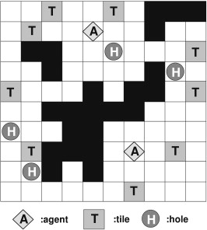
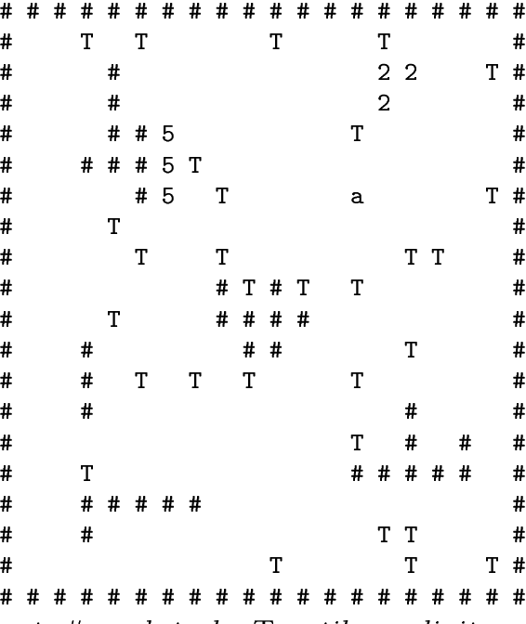
Tileworld
Agents
Tiles
Holes
Obstacles
Fuel Station
Dynamic environment

Slide 11
Let’s build the Tilesworld simulation
Agents: Very basic, “stupid” agents avoiding obstacles
Holes can have some score
Agents can make plans reasoning about their goles and trying to maximize their utility (score obtained)

Slide 12
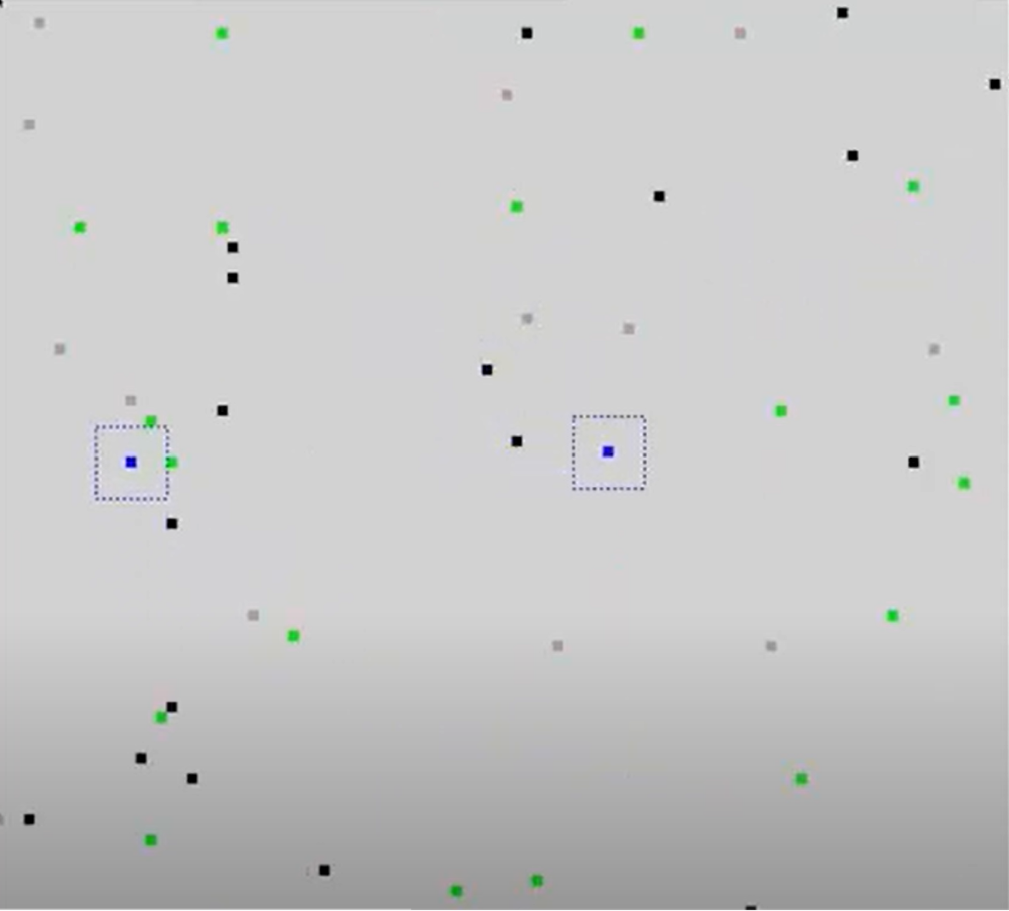
Assignment 1: Tileworld
Agents
Tiles
Holes
Obstacles
Fuel Station
Dynamic environment

Slide 13
Let’s build the Tilesworld simulation
In the Lab:
Complete the Agent’s implementation sensing Tiles and Holes
Implement the code for the environment (Context)
Implement the code for the Fuel Station
Remember: Agents decreases energy by moving
Environment is Static (doesn’t change)

Slide 14
Let’s build the Tilesworld simulation
Assigment Stage 1:
Complete the simulation setup.
Agents must pick tiles and put into holes achieving some Score, avoiding obstacles: Basic Planning
Considerations:
Should I pick a tile or should I recharge energy?
Is the energy enough for the nearest hole? Is it worthy?

Slide 15
Let’s build the Tilesworld simulation
Assigment Stage 2:
Agents must optimize resources: “Reasoning” about Tiles and Holes location: What is the best route given my resources: Planning
Environment must be dynamic (Changing every t steps)

Slide 16
Lab session
Customizing radio sensing of a single Agent
Agents Dynamic:
  Pick single tiles (store them in a List) and put into Holes while exploring the environment
  Increment the score as Holes are filled
  Explore while energy is available
  No obstacles
  Download the template code from Blackboard (Tileworld)

Slide 17
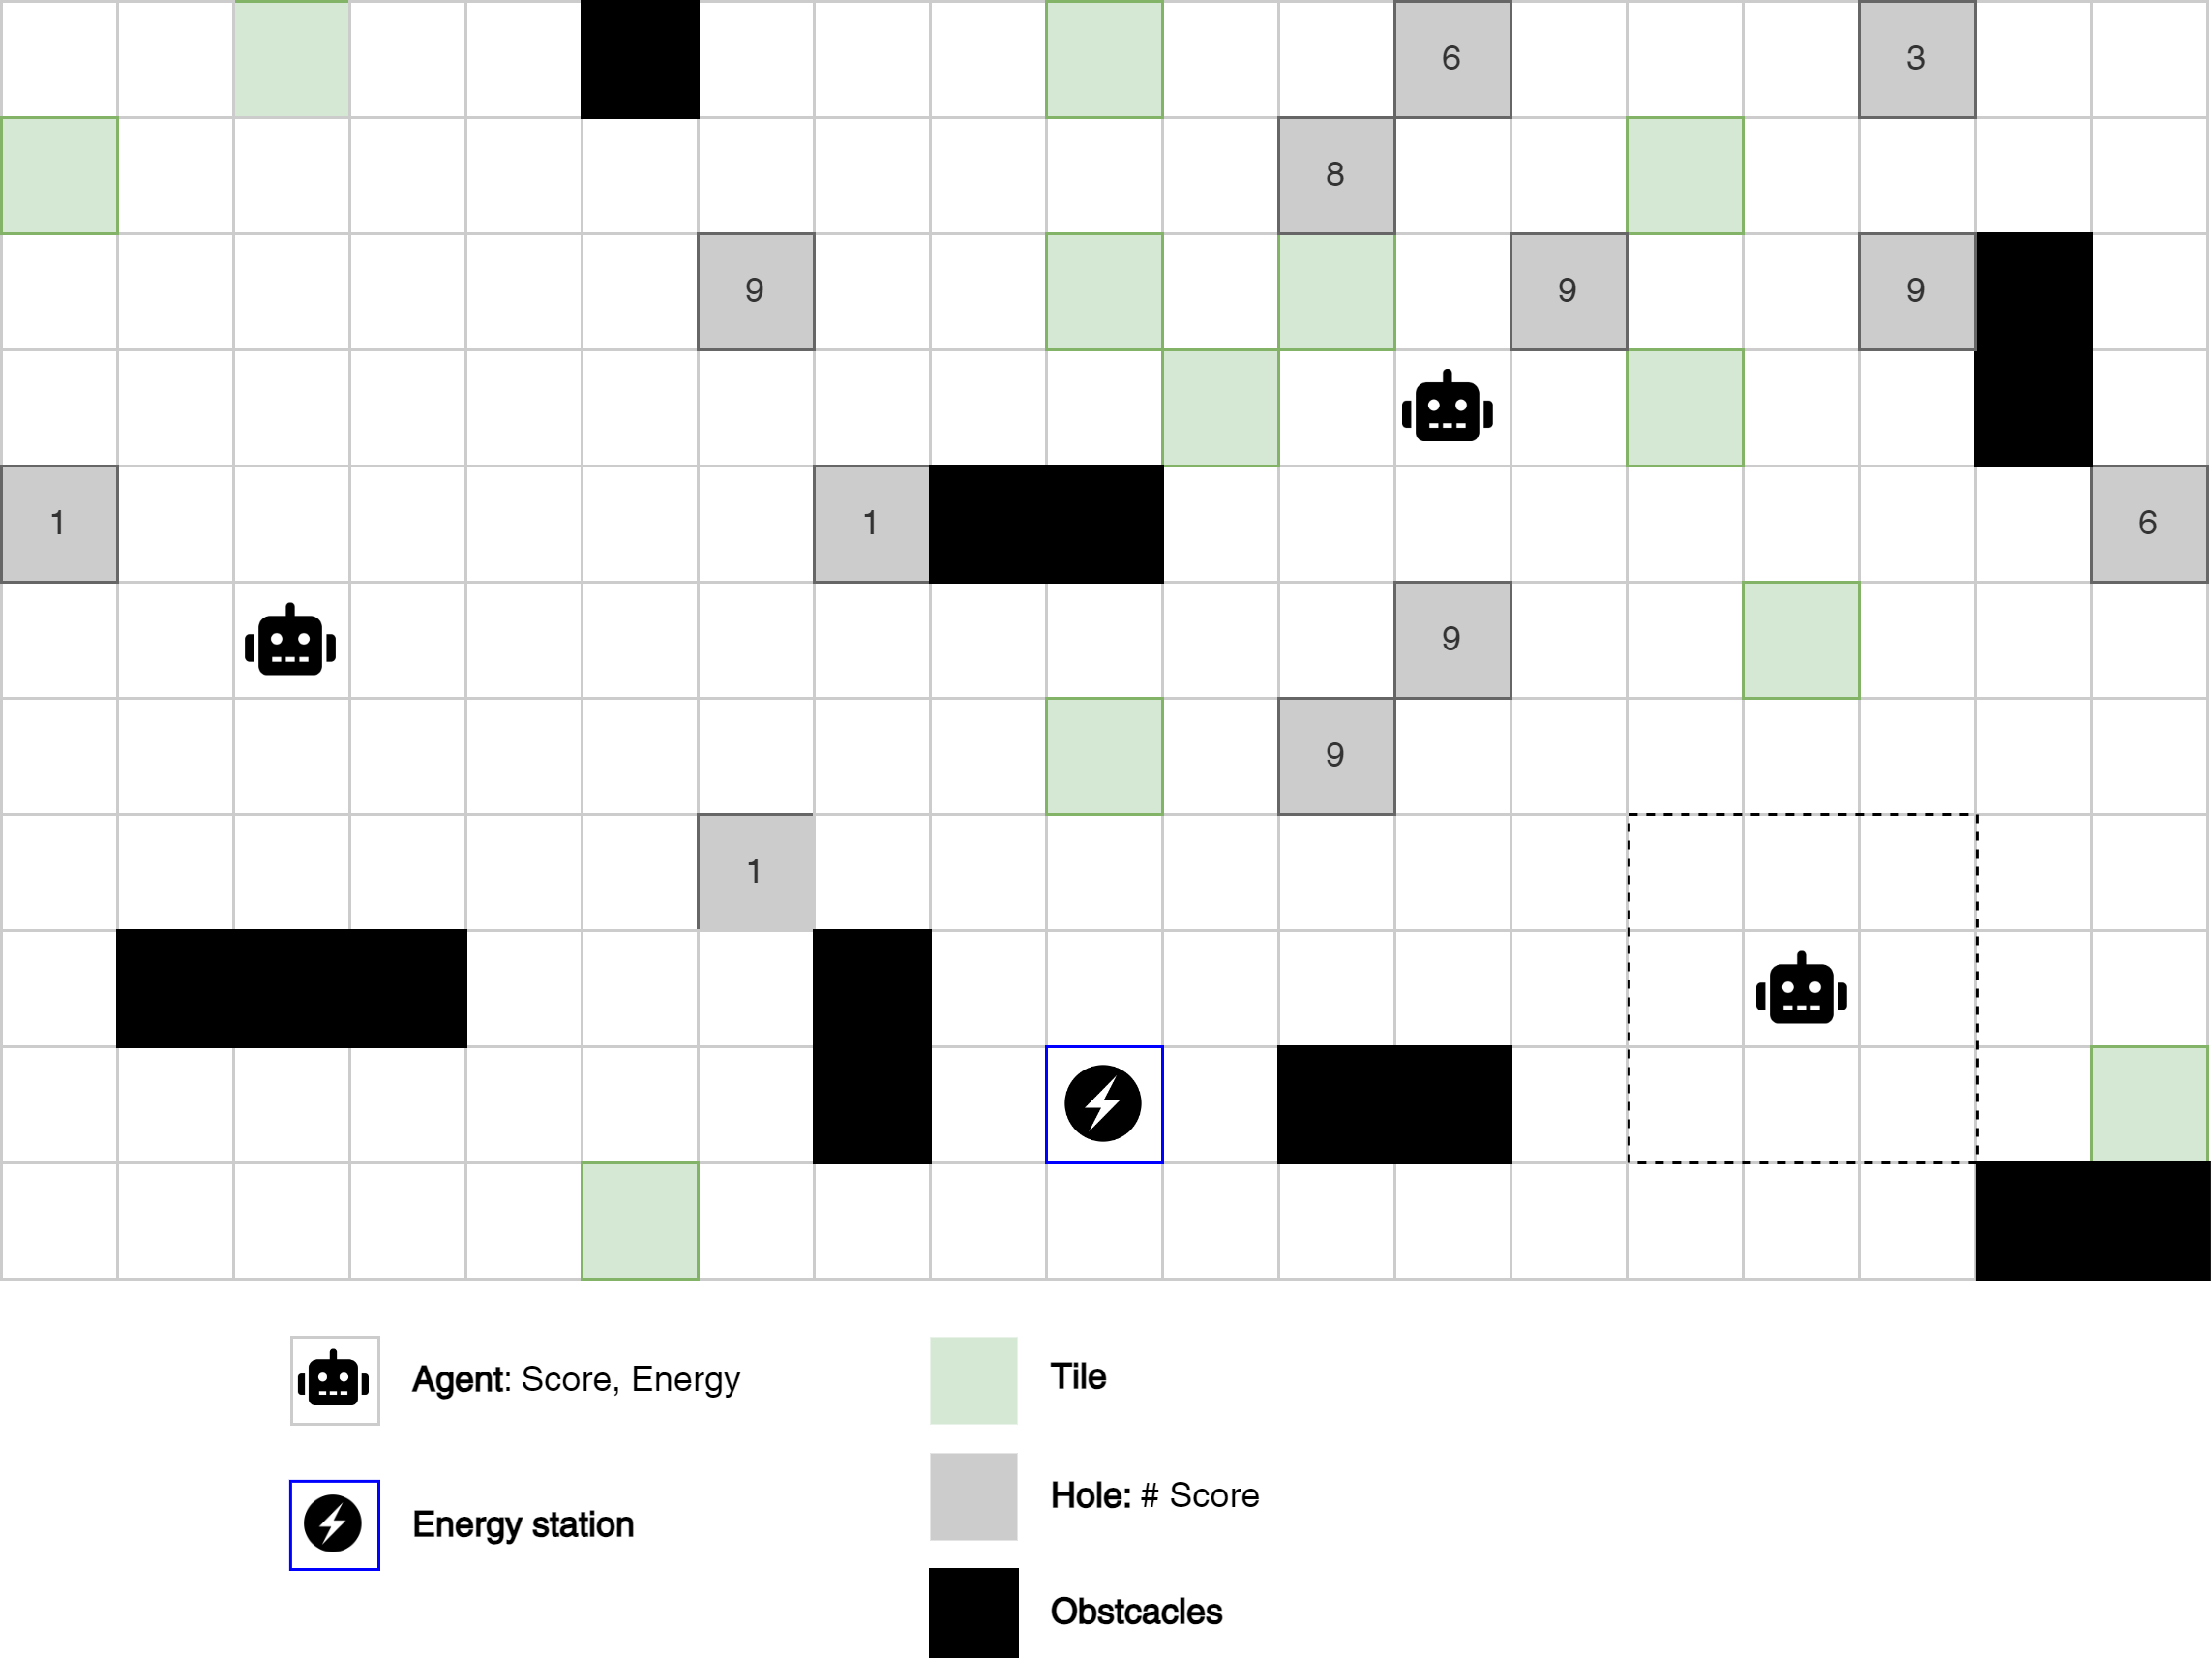
Tilesworld simulation

Slide 18
Assigment 1
Complete the Tileworld Simulation
Implement the obstacles
Change the “sensing” radio to “Map” the existing objects around as a list of Location. Hint: GridPoints
Implement the individual behavior to reach Tiles and Holes with the highest scores while Energy level is enough
Model a “communication” behavior to enable cooperation among Agents
Achieve the highest score as a Multiagent System

Slide 19
Let’s build the Tilesworld simulation
Assigment Stage 2:
Agents must optimize resources: “Reasoning” about Tiles and Holes location: What is the best route given my resources: Planning
Environment must be dynamic (Changing every t steps)

Slide 20
Sensing
  Has to be a tuple (type, x, y). Specified agents can see 5x5 sqaure:
  Note RePast allows each agent to see the entire context. You need to implement the sensing as set out in the problem.
  So you might define a method on the context class:
    Public ArrayList<Tuple> Sense(x,y,radius){
    //Return a list of tuples indicating Type (Hole, Obs, Tile) and position
    }

Slide 21
Example Reactive agent
Simple rules:
  If not carrying a tile process the list of objects and find the closest tile. Set goal to be location of closest tile.
  If carrying a tile process tuple list for nearest hole.
  What to do if we see new tile or whole on the way? Change goal?
  Move in general direction, use “stupid” obstacle avoidance.
  When nothing in sensor range do random movement until you find something.
  When fuel < 15 move to (0,0)

